Slide 1
sales Insights
Farhat Jahan Allah Baksh

Slide 2
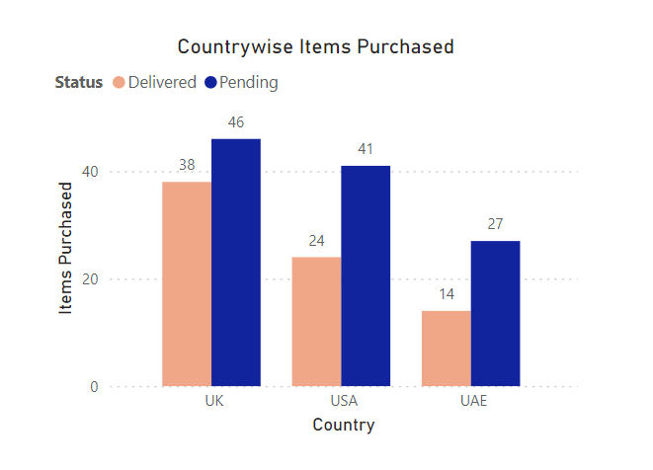
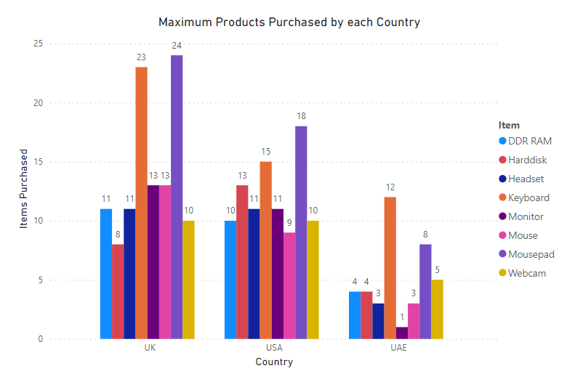
Country-wise sales
USA has the highest purchases and UAE has the least purchases
Pending orders are more than the delivered orders - Need more data like purchase date to understand why the orders are pending . Whether the order was placed on a holiday or is it the climatic conditions that stops the shipping process .
Mouse pad is the most purchased product in the US and the UK and Keyboard in the UAE.

Slide 3
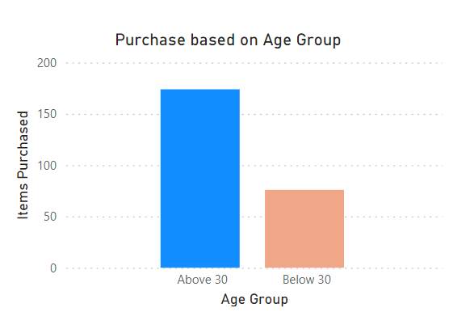
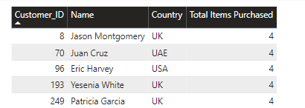
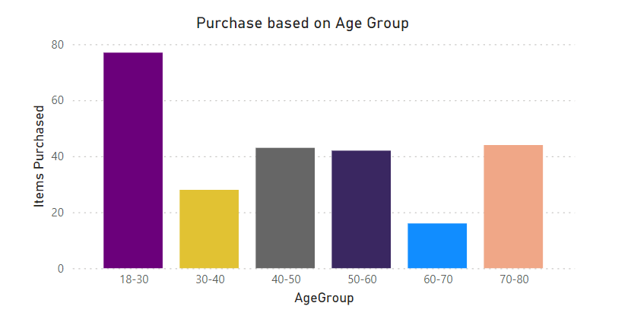
Customer Insights
Regular Purchasers
People above age group 30 have maximum purchase than below 30 – But splitting the age groups further the people between the age 18 and 30 have made more purchases .
The targeted audiences are people between 18 and 30.
Customer Job helps us to understand what kind of Job require our product the most

Slide 4
Data Requirements
Need to be created
Customer
Customer Id Country Age First Name Last Name Customer Job
Already Existing
Shipping
Shipping Id Customer Id Order Id Status
Order
Order Id Customer Id Total Amount Order Quality Status- Urgent/Normal Purchase Date
Product
Product Id Product Colour Order Id Product Cost
Product table is required to understand what kind of products are purchased and how much each quantity is purchased. Is it purchased as a whole or are there individual buyers .

